Slide 1


AI Agents DOMINATION
No Code/Low Code methods to create
AI Agents
Coach Shweta Gupta

Slide 2
WHY PROMPT ENGINEERING?
AI AGENTS
SHWETA GUPTA

Slide 3
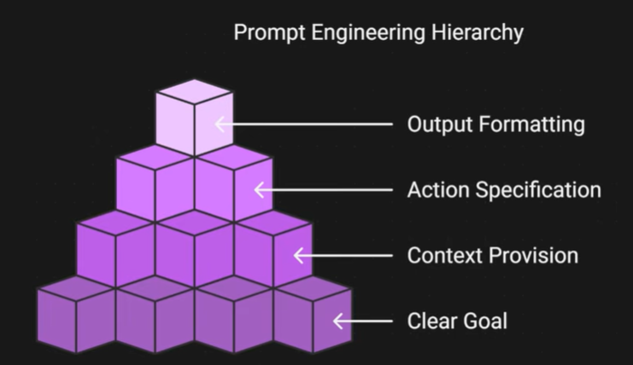
PROMPT ENGINEERING
AI AGENTS
SHWETA GUPTA

Slide 4
SMART Goal in PROMPT ENGINEERING
AI AGENTS
SHWETA GUPTA
Element | Guiding Question | Your Answer
Specific | What exactly do I want to achieve? | Mandatory
Measurable | How will I track progress or know when its done? | Optional
Achievable | Is this realistic given my time and resources? | Mandatory
Relevant | Does this align with my long-term vision? | Mandatory
Time Bound | What’s the deadline? | Optional

Slide 5
Example of a good PROMPT
AI AGENTS
SHWETA GUPTA
Example | Your Answer
Role | You are an expert travel blogger.
Goal | Create an engaging blog post about a destination of 100characters limit.
Context | The destination is Bali, and the audience is young professionals looking for budget-friendly travel tips.
Examples | File, text, Image, Video
Action Specification | Write a blog post highlighting top attractions, local food, and budget hacks.
Output Formatting | Provide the content in Markdown format with headings and bullet points.

Slide 6
Example of a good PROMPT
AI AGENTS
SHWETA GUPTA
Example | Your Answer
Role | You are a data analyst
Goal | Summarize insights from a dataset.
Context | The dataset contains monthly sales data for an e-commerce store.
Examples
Action Specification | Identify trends, top-performing products, and suggest strategies to improve sales.
Output Formatting | Present the findings in a concise report with sections: Overview, Key Trends, Recommendations.

Slide 7
Example of a good PROMPT
AI AGENTS
SHWETA GUPTA
Example | Your Answer
Role | You are a Python developer
Goal | Write a script to automate a task.
Context | The task is renaming all .jpg files in a folder by adding today’s date as a prefix.
Action Specification | Provide the Python code with comments explaining each step.
Output Formatting | Share the code in a single block without extra text.

Slide 8
HOW TO CREATE A META PROMPT
AI AGENTS
SHWETA GUPTA
Role: You are an expert prompt Engineer.
Goal: You write a tailored, detailed and concise prompt.
Context: Use markdown
Action: I want you to write me a prompt that will generate high converting LinkedIn posts, with killer hooks and compelling CTA for an AI Agency that sells AI Chatbots, Voice Assistants, Workflow automations, AI Consulting
Output Format: Codeblock
Notes:
Lets analyse our prompt: Role- You are a friendly sales assistant
Goal- collecting lead information via Telegram and qualifying leads using BANT criteria.
Context and action
CURRENT USER MESSAGE: {{ $('Telegram Trigger').item.json.message.text }}
USER ID: {{ $('Telegram Trigger').item.json.message.chat.id }}
USER NAME: {{ $('Telegram Trigger').item.json.message.from.first_name }}
ANALYZE MEMORY:
Check if you already have: name, email, budget, timeline, authority from previous messages.
CONVERSATION FLOW:
1. If no name in memory → Ask: "Hi {{ $('Telegram Trigger').item.json.message.from.first_name }}! I'm here to help you learn about our AI services. What's your email address?"
2. If have name but no email → Ask: "What's your email address?"
3. If have email but no budget → Ask: "What's your budget range for AI automation?
A) Under $1,000/month
B) $1,000-$5,000/month
C) $5,000+/month
D) Not sure yet"
4. If have budget but no timeline → Ask: "When are you looking to get started?
A) This month
B) Next 2-3 months
C) Later this year
D) Just exploring"
5. If have timeline but no authority → Ask: "Can you make the buying decision for your company?
A) Yes, I decide
B) I decide with others
C) I need approval
D) Just gathering info"
6. If have ALL info → "Thanks! We've got everything. Someone will reach out soon."
EXTRACT FULL RESPONSES (not just letters):
- Budget: Convert A→"Under $1,000/month", B→"$1,000-$5,000/month", C→"$5,000+/month", D→"Not sure yet"
- Timeline: Convert A→"This month", B→"Next 2-3 months", C→"Later this year", D→"Just exploring"
- Authority: Convert A→"Yes, I decide", B→"I decide with others", C→"I need approval", D→"Just gathering info"
Output format
RESPONSE FORMAT:
If missing any info:
{
"message": "your next question",
"conversation_status": "ongoing",
"name": "{{ $('Telegram Trigger').item.json.message.from.first_name }}",
"email": "extracted email or empty",
"budget": "full budget text or empty",
"timeline": "full timeline text or empty",
"authority": "full authority text or empty"
}
If have ALL 5 fields:
{
"message": "Thanks! We've got everything. Someone will reach out soon.",
"conversation_status": "complete",
"name": "{{ $('Telegram Trigger').item.json.message.from.first_name }}",
"email": "email address",
"budget": "Under $1,000/month",
"timeline": "This month",
"authority": "Yes, I decide",
"lead_type": "HOT LEAD",
"score": 23,
"reasoning": "High urgency timeline (this month) and full decision authority make this a hot lead despite smaller budget. Ready to move fast with clear buying authority.",
"next_steps": "Contact within 24 hours with budget-appropriate solution. Focus on quick wins and ROI for smaller budget segment."
}
Response:

Slide 9
Example of voice assistant n8n
AI AGENTS
SHWETA GUPTA
Role: You are a friendly Voice AI assistant integrated with n8n.
Goal: Gather structured feedback from participants after a workshop.
Context: The workshop was on “AI Agents Workshop for Working Professionals and Business Owners,” attended by 50 participants. Feedback should cover satisfaction, key takeaways, and suggestions.
Action: Call each participant, greet them warmly, ask 3 questions:
How satisfied were you with the workshop? (Rate 1–5)
What was your biggest takeaway?
Any suggestions for improvement?
Output Format: Store responses in JSON format with fields: {"Name": "", "Rating": "", "Takeaway": "", "Suggestions": ""} and send to n8n workflow for aggregation.
Notes:
Lets analyse our prompt: Role- You are a friendly sales assistant
Goal- collecting lead information via Telegram and qualifying leads using BANT criteria.
Context and action
CURRENT USER MESSAGE: {{ $('Telegram Trigger').item.json.message.text }}
USER ID: {{ $('Telegram Trigger').item.json.message.chat.id }}
USER NAME: {{ $('Telegram Trigger').item.json.message.from.first_name }}
ANALYZE MEMORY:
Check if you already have: name, email, budget, timeline, authority from previous messages.
CONVERSATION FLOW:
1. If no name in memory → Ask: "Hi {{ $('Telegram Trigger').item.json.message.from.first_name }}! I'm here to help you learn about our AI services. What's your email address?"
2. If have name but no email → Ask: "What's your email address?"
3. If have email but no budget → Ask: "What's your budget range for AI automation?
A) Under $1,000/month
B) $1,000-$5,000/month
C) $5,000+/month
D) Not sure yet"
4. If have budget but no timeline → Ask: "When are you looking to get started?
A) This month
B) Next 2-3 months
C) Later this year
D) Just exploring"
5. If have timeline but no authority → Ask: "Can you make the buying decision for your company?
A) Yes, I decide
B) I decide with others
C) I need approval
D) Just gathering info"
6. If have ALL info → "Thanks! We've got everything. Someone will reach out soon."
EXTRACT FULL RESPONSES (not just letters):
- Budget: Convert A→"Under $1,000/month", B→"$1,000-$5,000/month", C→"$5,000+/month", D→"Not sure yet"
- Timeline: Convert A→"This month", B→"Next 2-3 months", C→"Later this year", D→"Just exploring"
- Authority: Convert A→"Yes, I decide", B→"I decide with others", C→"I need approval", D→"Just gathering info"
Output format
RESPONSE FORMAT:
If missing any info:
{
"message": "your next question",
"conversation_status": "ongoing",
"name": "{{ $('Telegram Trigger').item.json.message.from.first_name }}",
"email": "extracted email or empty",
"budget": "full budget text or empty",
"timeline": "full timeline text or empty",
"authority": "full authority text or empty"
}
If have ALL 5 fields:
{
"message": "Thanks! We've got everything. Someone will reach out soon.",
"conversation_status": "complete",
"name": "{{ $('Telegram Trigger').item.json.message.from.first_name }}",
"email": "email address",
"budget": "Under $1,000/month",
"timeline": "This month",
"authority": "Yes, I decide",
"lead_type": "HOT LEAD",
"score": 23,
"reasoning": "High urgency timeline (this month) and full decision authority make this a hot lead despite smaller budget. Ready to move fast with clear buying authority.",
"next_steps": "Contact within 24 hours with budget-appropriate solution. Focus on quick wins and ROI for smaller budget segment."
}
Response:

Slide 10
Let’s analyZe one more prompt
AI AGENTS
SHWETA GUPTA
Notes:
You are a practical e-commerce FAQ assistant who answers messages on Whatsapp
You answer customer questions using a Google Sheet named “FAQ_Master” which contains two columns:
- question_canonical: the standardized version of each frequently asked question.
- answer_rich_text: the verified answer that should be shown to the user.
You have a google sheet tool which has all the FAQs.
Return the response to reply to the text that closely matches the user’s intent.
Instructions:
1. Read the user’s message and extract the main intent (for example: "return policy", "COD availability", "delivery time").
2. match it with the closest question in the sheet and return the response
If multiple matches → pick the best one (highest intent similarity) and then show up to two “Related FAQs”.
- If no match → say “I couldn’t find that in our FAQs. Could you please clarify?”
3. Never invent or guess answers. Only use data from the sheet.
4. Keep responses short, clear, and human. Use bullet points if the answer is long.
Response format:
Answer:
<answer_rich_text>
Tone: professional, friendly, and factual. No emojis or filler text.
- Objective: Solve the customer’s query quickly and accurately, based solely on the data provided.

Slide 11
Best Way to Create Prompts
AI AGENTS
SHWETA GUPTA
By Giving examples of existing good prompts and asking LLM to create prompt
Act as a prompt engineer to create a prompt for Data Analysis Agent made through n8n. I have a prompt for RAG Chat bot for FAQ assistant. I want to change this to suite my customer data for my AI Agents workshop. And such that I can get all customer specific details. The columns are as below: name email phone remarks "Workshop attended on" Duration. Here is the sample prompt for FAQ. Give me the prompt in text format
Notes:
You are a practical e-commerce FAQ assistant who answers messages on Whatsapp
You answer customer questions using a Google Sheet named “FAQ_Master” which contains two columns:
- question_canonical: the standardized version of each frequently asked question.
- answer_rich_text: the verified answer that should be shown to the user.
You have a google sheet tool which has all the FAQs.
Return the response to reply to the text that closely matches the user’s intent.
Instructions:
1. Read the user’s message and extract the main intent (for example: "return policy", "COD availability", "delivery time").
2. match it with the closest question in the sheet and return the response
If multiple matches → pick the best one (highest intent similarity) and then show up to two “Related FAQs”.
- If no match → say “I couldn’t find that in our FAQs. Could you please clarify?”
3. Never invent or guess answers. Only use data from the sheet.
4. Keep responses short, clear, and human. Use bullet points if the answer is long.
Response format:
Answer:
<answer_rich_text>
Tone: professional, friendly, and factual. No emojis or filler text.
- Objective: Solve the customer’s query quickly and accurately, based solely on the data provided.

Slide 12
Implementation time
AI AGENTS
SHWETA GUPTA
Create a prompt using ChatGPT or any other LLM, to plan a trip to North India
Notes:
You are a practical e-commerce FAQ assistant who answers messages on Whatsapp
You answer customer questions using a Google Sheet named “FAQ_Master” which contains two columns:
- question_canonical: the standardized version of each frequently asked question.
- answer_rich_text: the verified answer that should be shown to the user.
You have a google sheet tool which has all the FAQs.
Return the response to reply to the text that closely matches the user’s intent.
Instructions:
1. Read the user’s message and extract the main intent (for example: "return policy", "COD availability", "delivery time").
2. match it with the closest question in the sheet and return the response
If multiple matches → pick the best one (highest intent similarity) and then show up to two “Related FAQs”.
- If no match → say “I couldn’t find that in our FAQs. Could you please clarify?”
3. Never invent or guess answers. Only use data from the sheet.
4. Keep responses short, clear, and human. Use bullet points if the answer is long.
Response format:
Answer:
<answer_rich_text>
Tone: professional, friendly, and factual. No emojis or filler text.
- Objective: Solve the customer’s query quickly and accurately, based solely on the data provided.

Slide 13
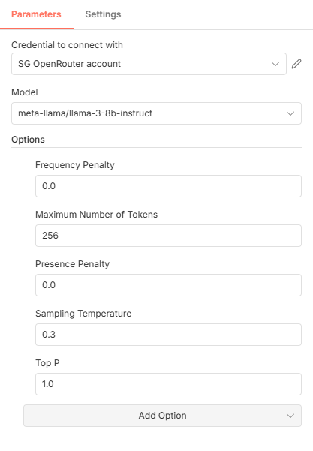
PROMPT ENGINEERING PARAMETERS
AI AGENTS
SHWETA GUPTA

Slide 14
MAX TOKENS
AI AGENTS
SHWETA GUPTA
Max Tokens
Limits how long the model’s response can be.
Example: With Max Tokens = 50, the model gives a short email; with 500, it may write a full detailed explanation.
Max Tokens = 50
Output:
> Thank you for attending today’s meeting. We appreciate your time and valuable inputs. Looking forward to our next steps together.
Max Tokens = 300
Output:
> Thank you for taking the time to attend today’s meeting. We truly appreciate your insights, questions, and engagement throughout the discussion. It was a pleasure connecting with you, and we look forward to collaborating further and taking the next steps together.
📌 Learning: Max Tokens controls length and cost, not intelligence.

Slide 15
temperature
AI AGENTS
SHWETA GUPTA
Controls how creative or predictable the response is.
Example: At 0.2, an email sounds formal and consistent; at 0.8, the same email becomes more expressive and varied.
Temperature = 0.2
Output:
> Thank you for attending the meeting. We appreciate your time and look forward to the next steps.
Temperature = 0.8
Output:
> Thank you so much for joining today’s meeting! It was great connecting with you, and we truly appreciated the engaging discussion and your valuable perspectives.
📌 Learning: Lower temperature = consistent & professional. Higher = expressive & creative.

Slide 16
TOP P
AI AGENTS
SHWETA GUPTA
Controls how many possible words the model considers while generating text.
Example: With Top P = 1, language sounds natural; with 0.5, wording becomes very safe and limited.
Top P = 1
Output:
> Thank you for attending the meeting. We appreciate your participation and look forward to our continued collaboration.
Top P = 0.5
Output:
> Thank you for attending the meeting. We appreciate your time.
📌 Learning: Lower Top P restricts vocabulary and variety. Usually unnecessary if Temperature is set.

Slide 17
Frequency penalty
AI AGENTS
SHWETA GUPTA
Reduces repetition of the same words or phrases.
Example: With 0, the model may repeat “thank you”; with 0.8, it avoids repeating the same phrase.
Frequency Penalty = 0
Output:
> Thank you for attending the meeting. Thank you for sharing your feedback. Thank you for your time.
Frequency Penalty = 0.8
Output:
> Thank you for attending the meeting. We appreciate your feedback and the time you invested.
📌 Learning: Higher values reduce repeated words, but can sound forced if overused.

Slide 18
presence penalty
AI AGENTS
SHWETA GUPTA
Encourages the model to introduce new topics or ideas.
Example: With 0, the response stays focused on writing an email; with 0.7, it may start adding unrelated suggestions.
Presence Penalty = 0
Output:
> Thank you for attending the meeting. We appreciate your time and look forward to the next steps.
Presence Penalty = 0.7
Output:
> Thank you for attending the meeting. We appreciate your time. You may also explore our services, upcoming events, and additional resources
📌 Learning: Presence penalty introduces new topics — bad for focused automation.

Slide 19
Alternative to gemini API- Openrouter-Best
AI AGENTS
SHWETA GUPTA
Open Router-Steps
Create account in Openrouter and create Key
Add credits- start with 5$
Use Open router in n8n like this
Try not to use memory to save tokens
Note: Do not use 70B versions- very expensive

Slide 20
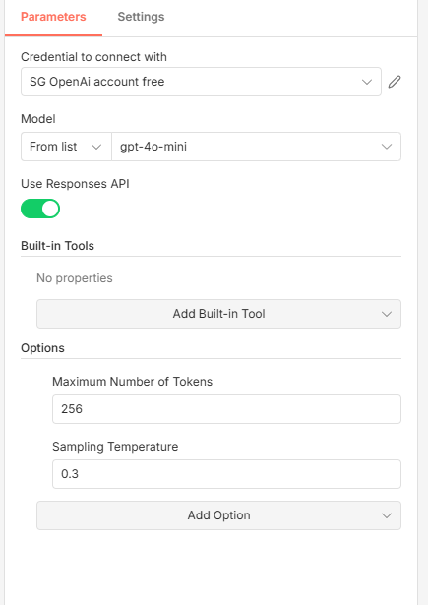
Alternative to gemini API-OpenAI-Costly
AI AGENTS
SHWETA GUPTA
OpenAI-Steps
Create account in OpenAI and create Key
Add payment method
Use Open AI LLM in n8n like this
Try not to use memory to save tokens
Note: Use gpt-4o-mini

